Slide 1
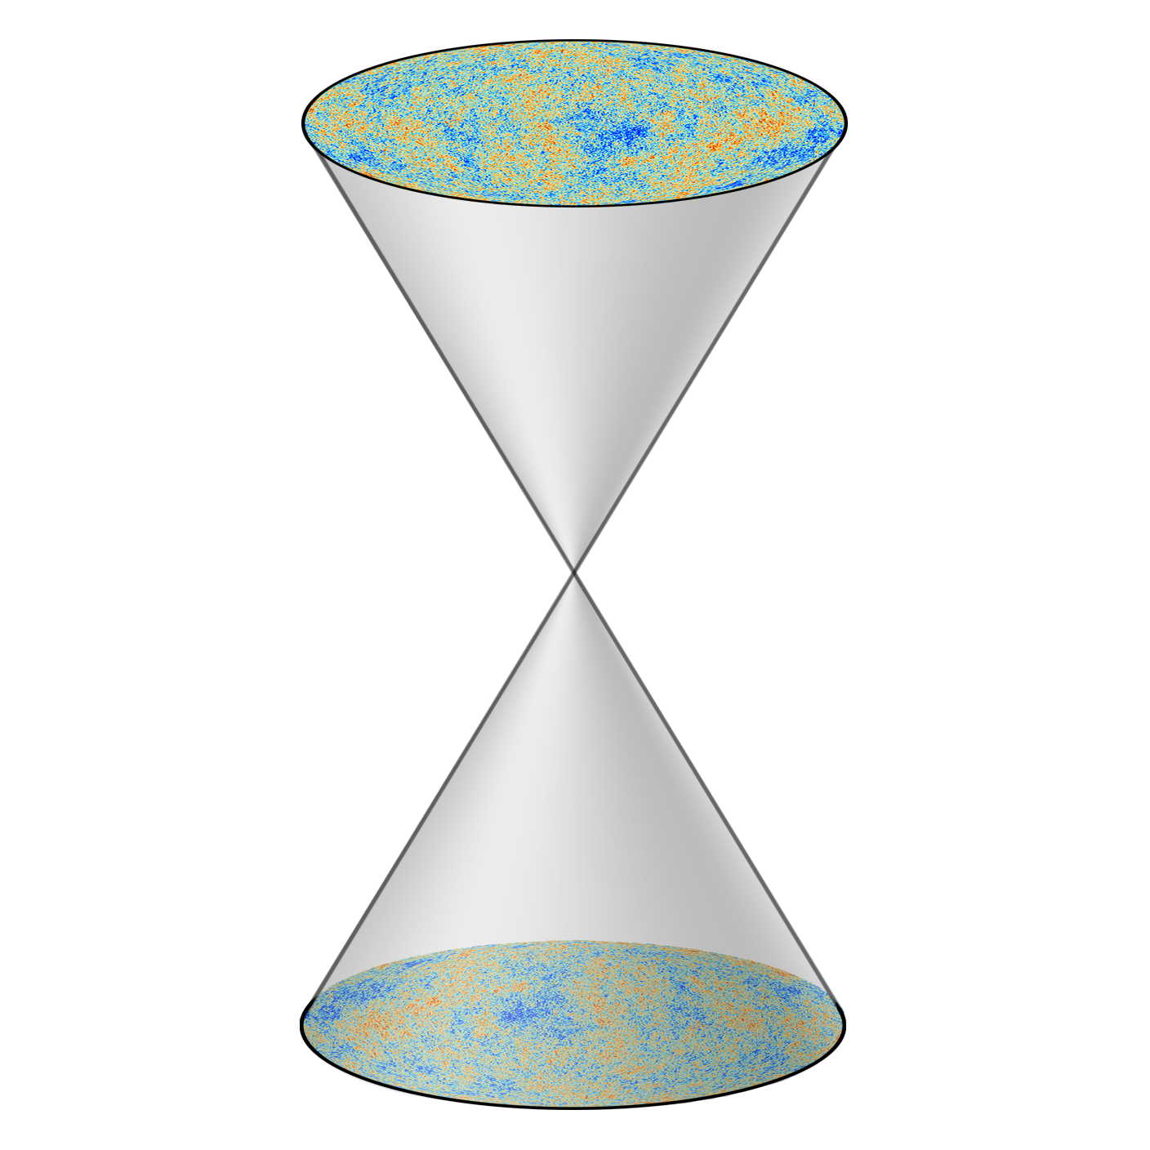
The finite geometry of spacetime:
(some clues from cosmology and the standard model)
Latham Boyle (Perimeter Institute)
Based on:
arXiv:1803.08928 (PRL 2018) “CPT Symmetric Universe” (with Kieran Finn and Neil Turok)
arXiv:1604.00847 (JHEP 2018) and work in progress (with Shane Farnsworth)

Slide 2
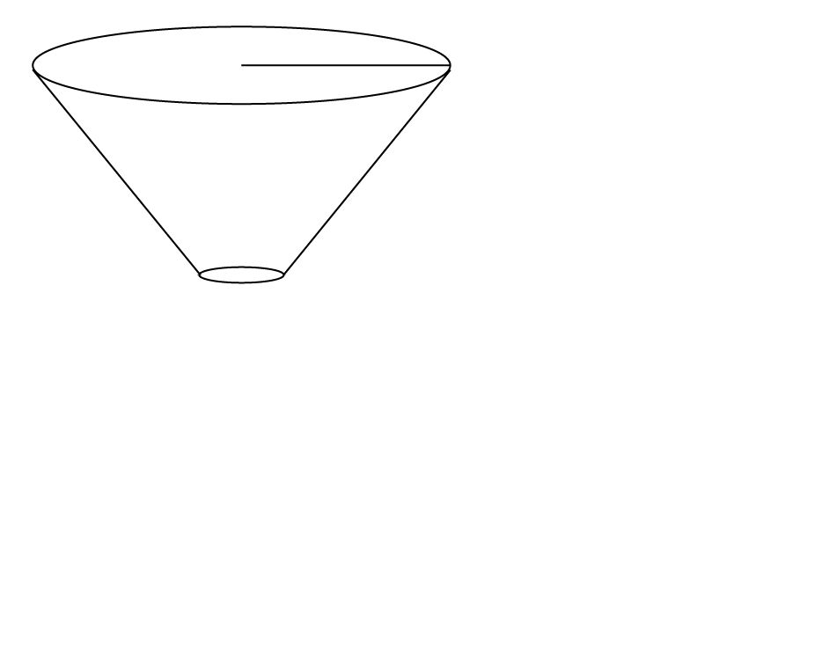

Slide 5
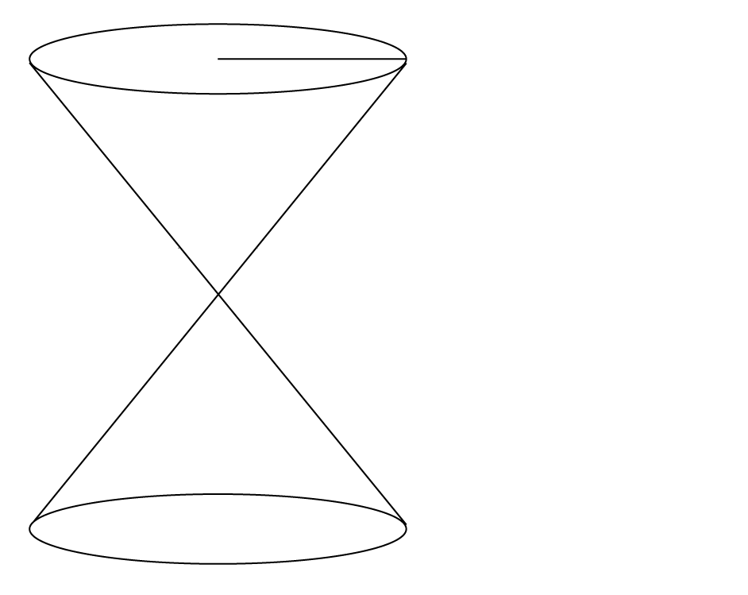

Slide 15
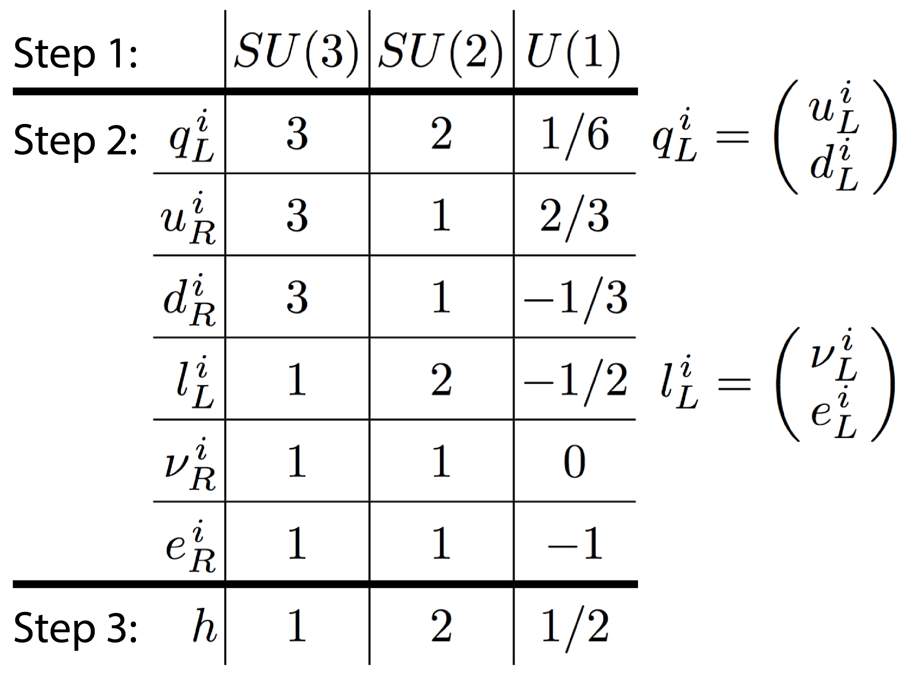
The standard model

Slide 16
The standard model

Slide 17
The standard model

Slide 18
The standard model

Slide 19
The standard model

Slide 20
The standard model

Slide 21
The standard model

Slide 22
The standard model

Slide 23
The standard model

Slide 24
The standard model

Slide 25
The standard model

Slide 26
The standard model

Slide 27
The standard model

Slide 28
The standard model

Slide 29
The standard model

Slide 30
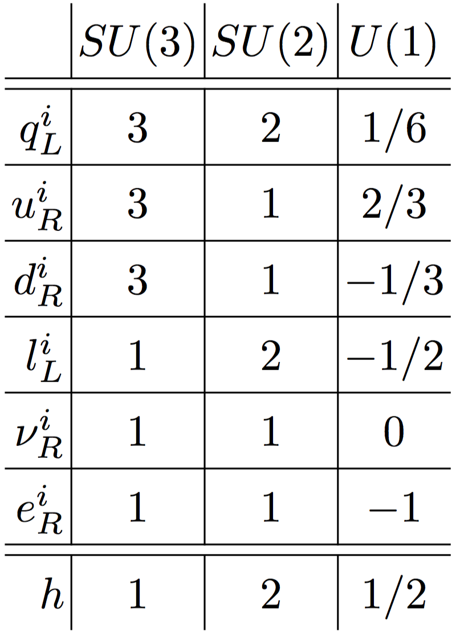

Slide 38
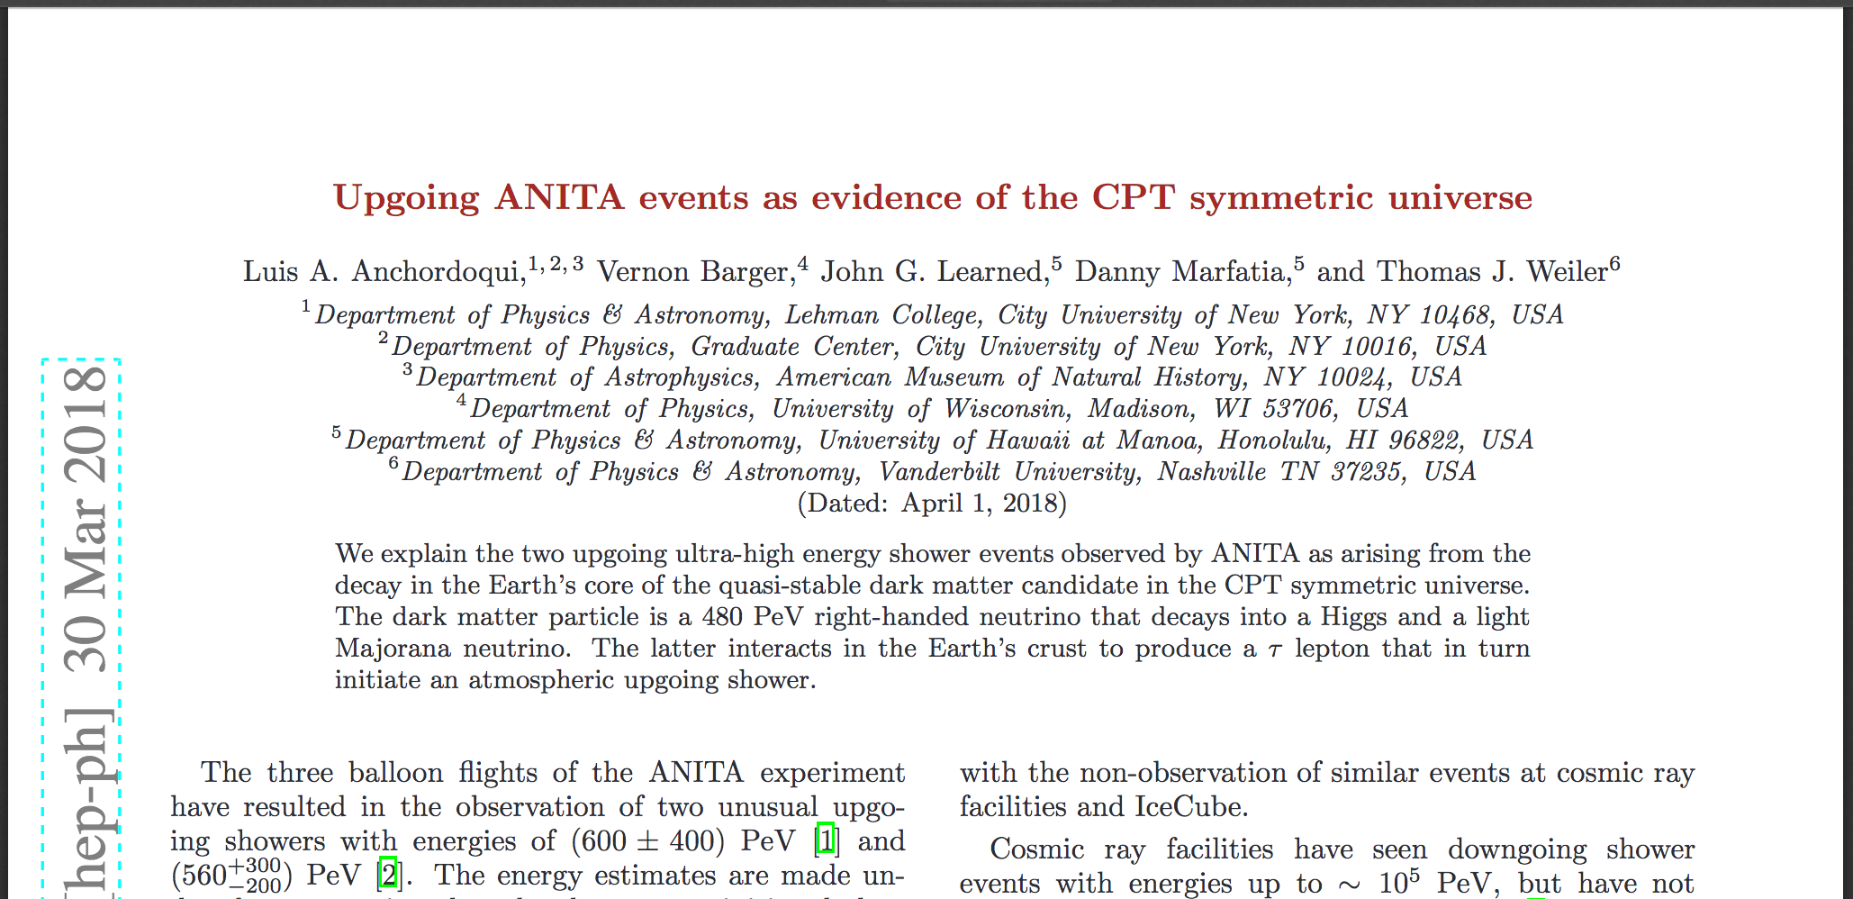

Slide 44
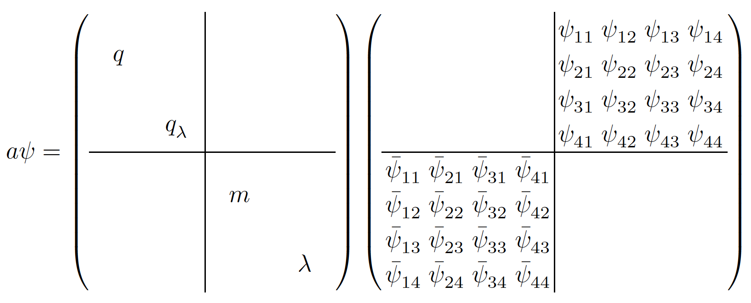

Slide 48
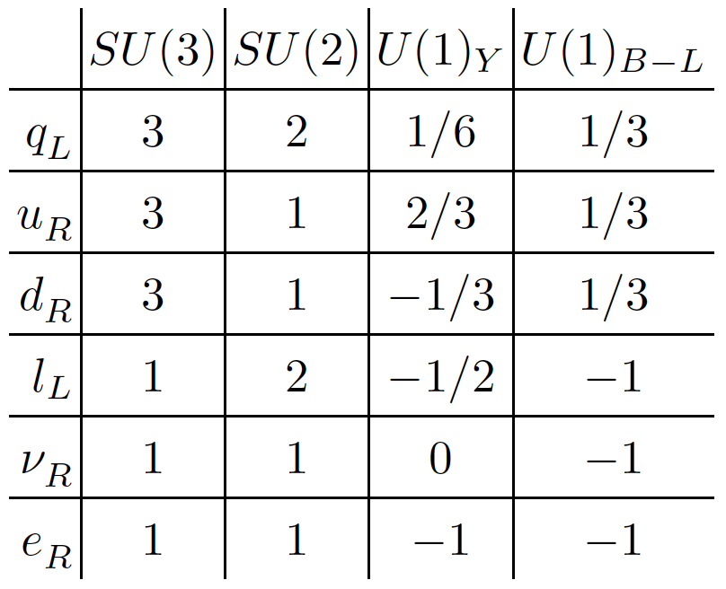

Slide 49
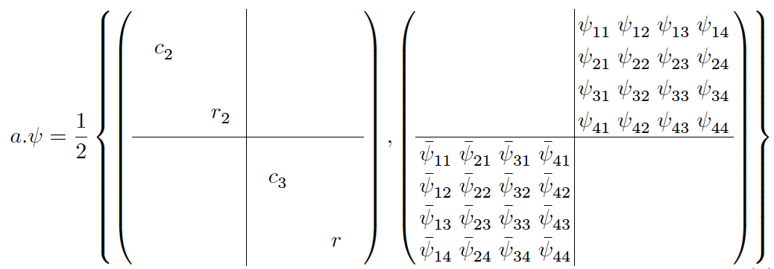

Slide 53
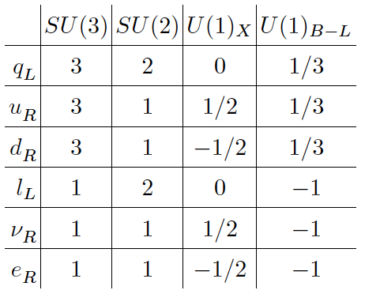

Slide 54
Connection to arXiv:1808.08110
By Dubois-Violette and Todorov?

Slide 55
Thank you!

Slide 56
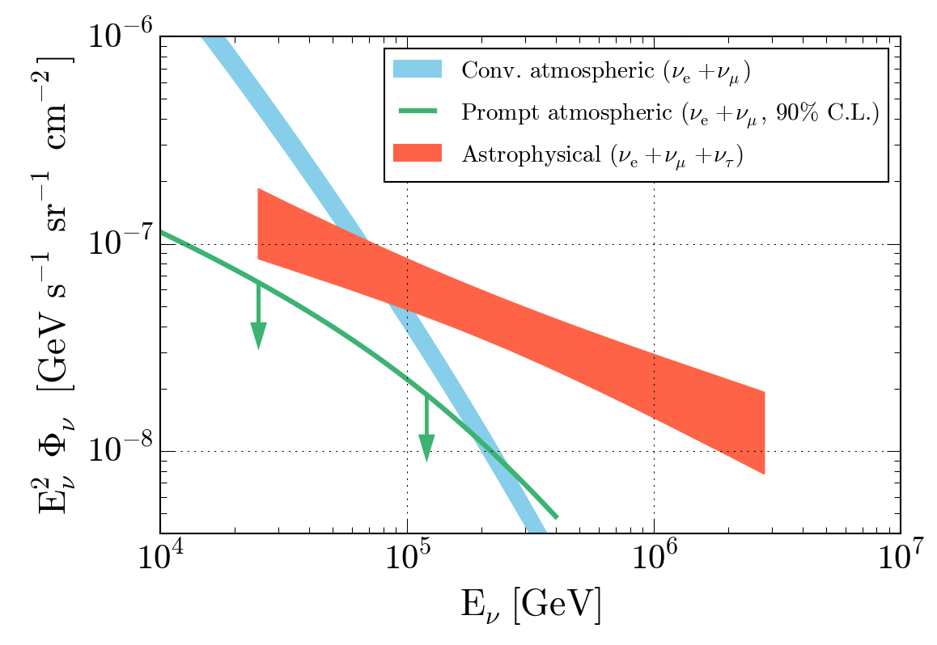

Slide 57
